Slide 1
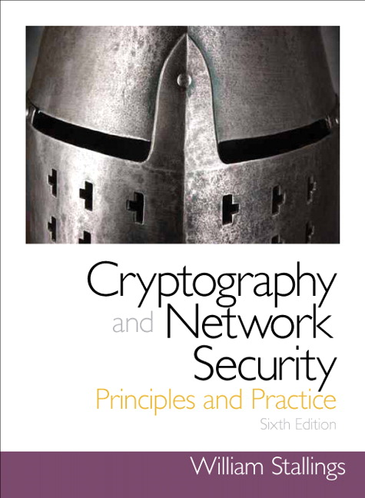
Chapter 5
Advanced Encryption Standard

Slide 2
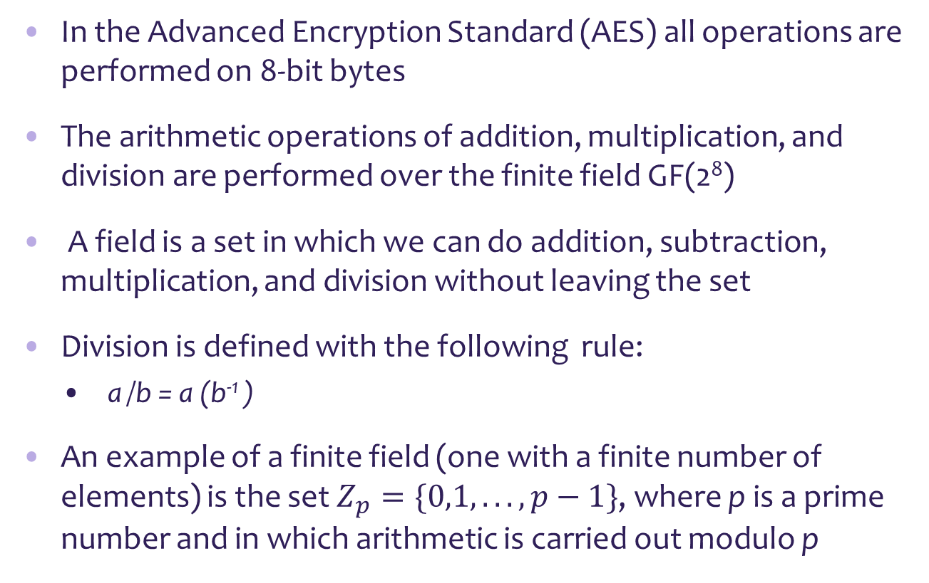
Finite Field Arithmetic
In the Advanced Encryption Standard (AES) all operations are performed on 8-bit bytes
The arithmetic operations of addition, multiplication, and division are performed over the finite field GF(2⁸)
A field is a set in which we can do addition, subtraction, multiplication, and division without leaving the set
Division is defined with the following rule:
a /b = a (b⁻¹ )
An example of a finite field (one with a finite number of elements) is the set $Z_{p}=\{0,1, . . . , p−1\}$, where p is a prime number and in which arithmetic is carried out modulo p

Slide 3
Finite Field Arithmetic
If one of the operations used in the algorithm is division, then we need to work in arithmetic defined over a field
Division requires that each nonzero element have a multiplicative inverse
For efficiency we work with integers that fit exactly into a given number of bits
Integers in the range $0$through $2^{n}$-1, which fit into an n-bit word
Integers in the range 0 through 2^𝑛-1, which fit into an n-bit word
The set of such integers, $Z_{2^{n}}$, using modular arithmetic, is not a field
The set of such integers, 𝑍_(2^𝑛 ), using modular arithmetic, is not a field
For example, the integer $2$ has no multiplicative inverse in $Z_{2^{n}}:$ there is no integer $b$, such that $2b$ mod${ 2}^{n}$ = 1.
For example, the integer 2 has no multiplicative inverse in 𝑍_(2^𝑛 ): there is no integer 𝑏, such that 2𝑏 mod〖 2〗^𝑛 = 1.
We use the finite field GF(2^{n})
Every polynomial in $GF(2n)$ can be represented by an $n$-bit number
Every polynomial in 𝐺𝐹(2^{𝑛}) can be represented by an 𝑛-bit number

Slide 4
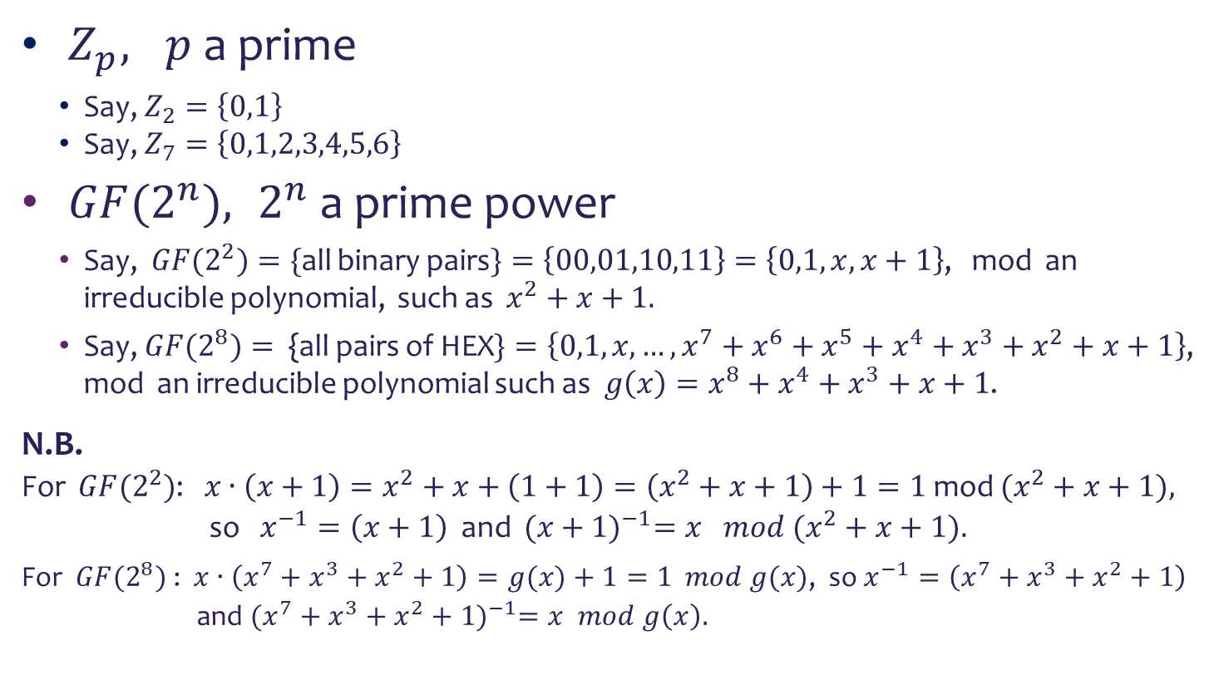
Examples
$Z_{p}, p$ a prime
Say, $Z_{2}=\left\{0,1\right\}$
Say, $Z_{7}=\left\{0,1,2,3,4,5,6\right\}$
${GF(2}^{n}), 2^{n}$ a prime power
Say, $GF{(2}^{2})=\{$all binary pairs$\}=\left\{00,01,10,11\right\}=\left\{0,1,x,x+1\right\}$, mod an irreducible polynomial, such as $x^{2}+x+1.$
Say, ${GF(2}^{8})=${all pairs of HEX$\}=\left\{0,1,x, …, x^{7}+x^{6}+x^{5}+x^{4}+x^{3}+x^{2}+x+1\right\}$, mod an irreducible polynomial such as ${g\left(x\right)=x}^{8}+x^{4}+x^{3}+x+1$.
N.B.
For $GF{(2}^{2})$: $x∙\left(x+1\right)=x^{2}+x+\left(1+1\right)=\left(x^{2}+x+1\right)+1=1$ mod $(x^{2}+x+1),$
so $x^{−1}=\left(x+1\right)$ and ${ (x+1)}^{−1}=x mod (x^{2}+x+1).$
For ${GF(2}^{8})$: $x∙\left(x^{7}+x^{3}+x^{2}+1\right)=g(x)+1=1$ $mod g(x)$, so $x^{−1}=\left(x^{7}+x^{3}+x^{2}+1\right)$
and ${(x^{7}+x^{3}+x^{2}+1)}^{−1}=x mod g\left(x\right).$

Slide 5
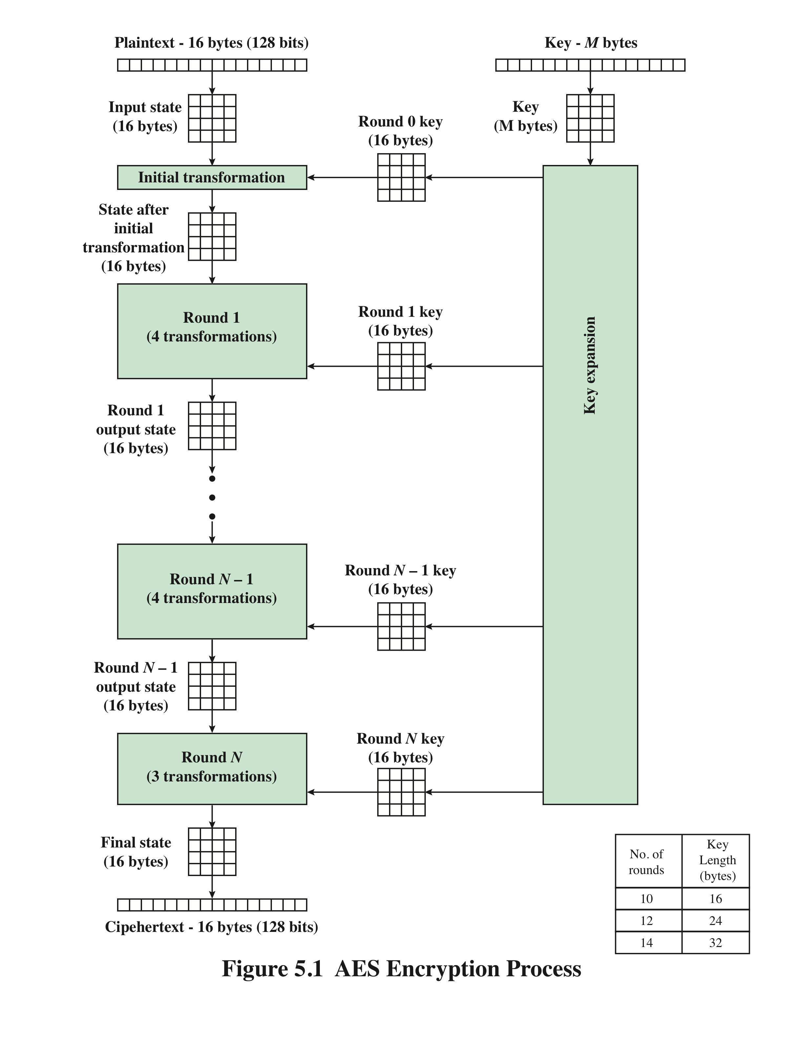
AES Encryption Process
plaintext: 128 bits
ciphertext: 128 bits
key: 128 bits (or 192 or 256 bits)
no of rounds: 10 (or 12 or 14)

Slide 6
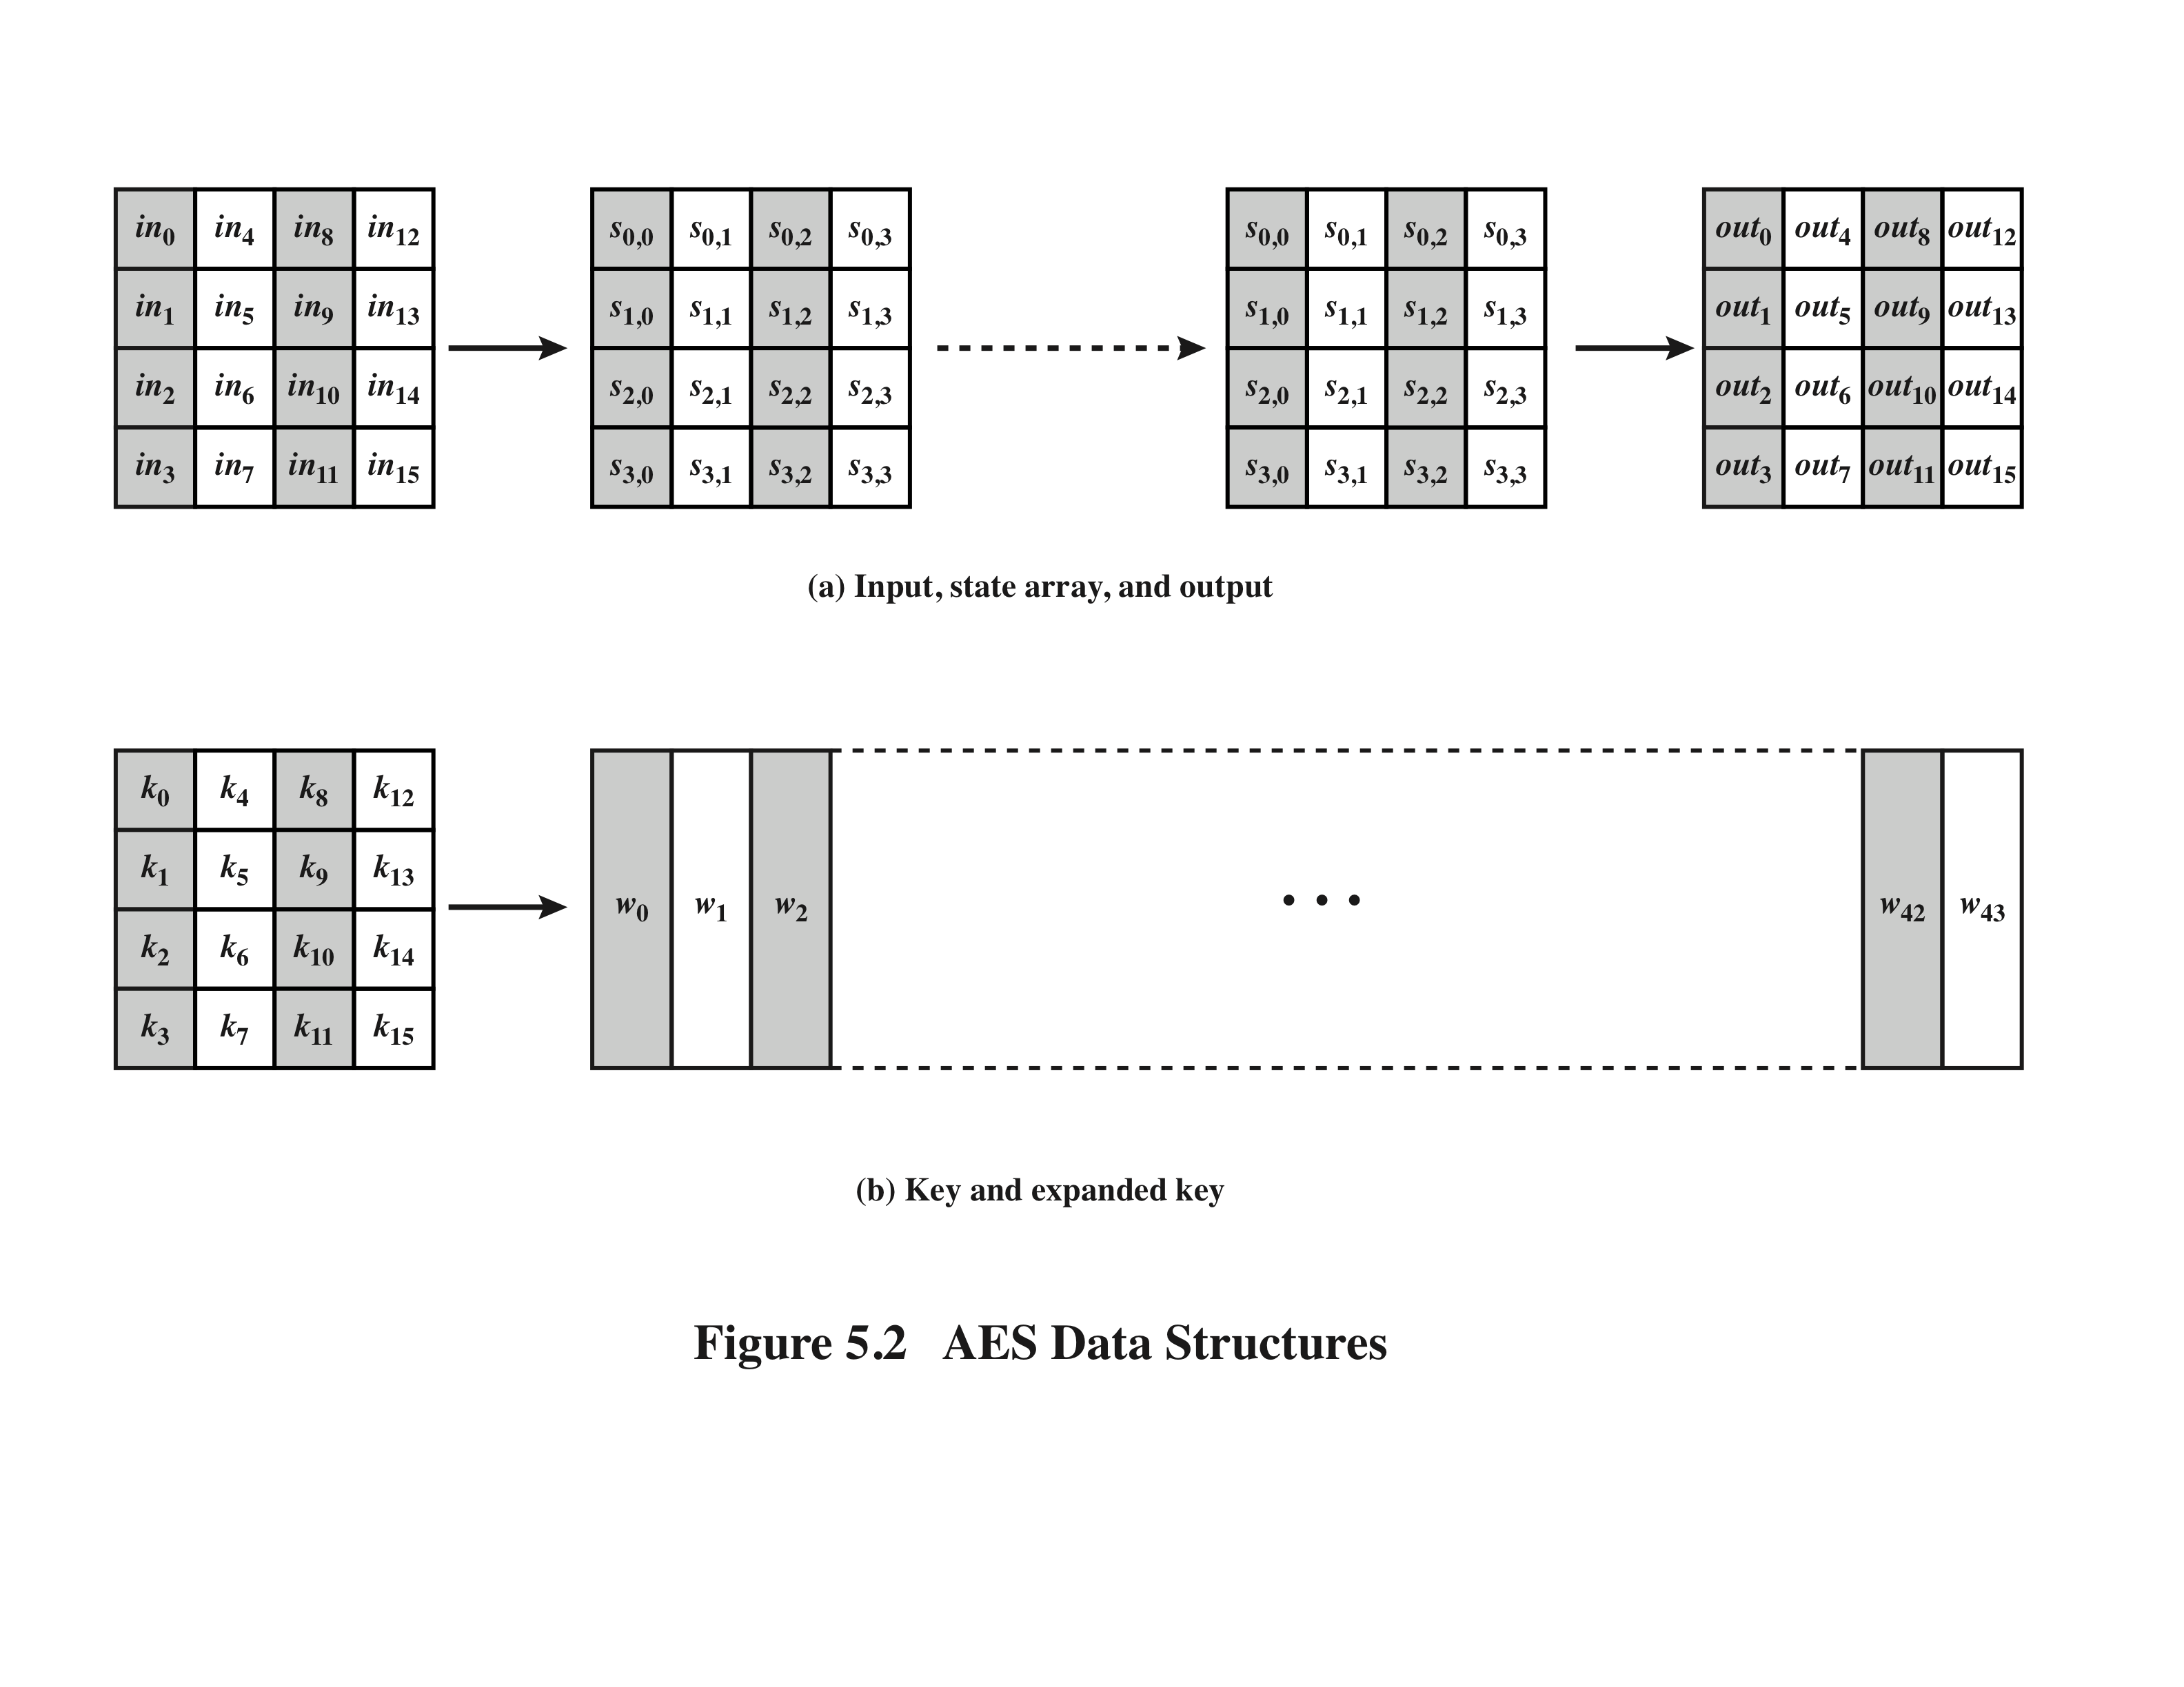
AES Data Structures

Slide 7
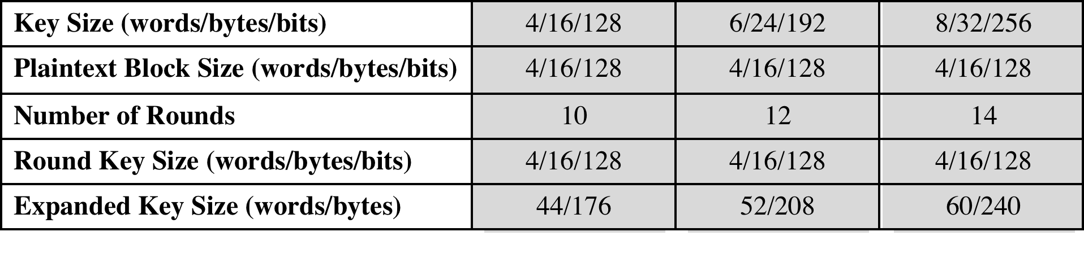
Table 5.1 AES Parameters
Basic version
Top secret

Slide 8
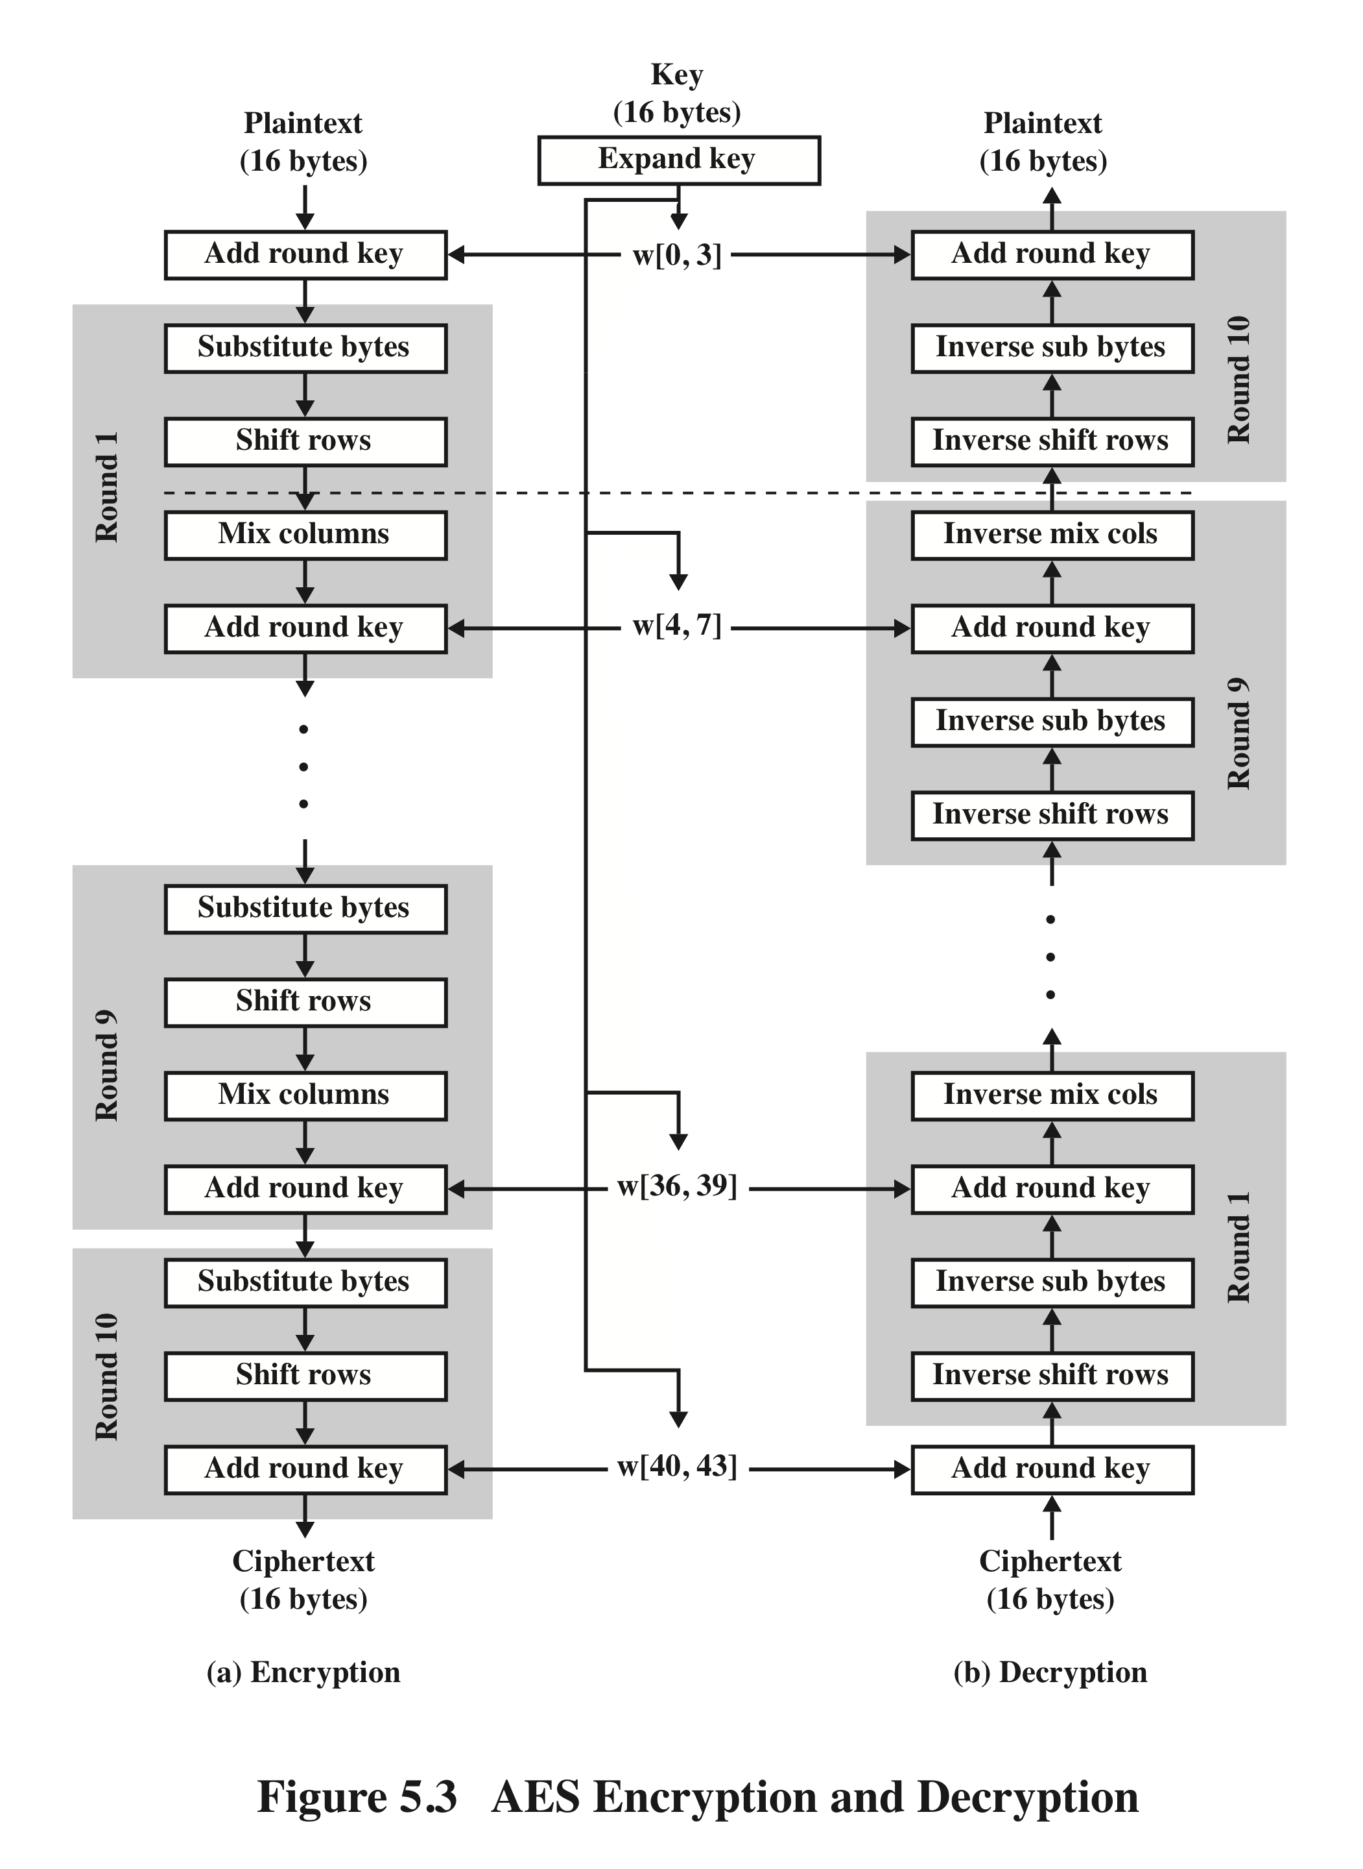
AES Encryption and Decryption

Slide 9
Detailed Structure
The entire data block is processed as a single matrix during each round using substitutions and permutation
The key that is provided as input is expanded into an array of forty-four 32-bit words, w[i]
The cipher begins and ends with an AddRoundKey stage
Can view the cipher as alternating operations of XOR encryption (AddRoundKey) of a block, followed by scrambling of the block (the other three stages), followed by XOR encryption, and so on
Each stage is easily reversible
The decryption algorithm makes use of the expanded key in reverse order, however the decryption algorithm is not identical to the encryption algorithm
State is the same for both encryption and decryption
Final round of both encryption and decryption consists of only three stages
Four different stages are used:
AddRoundKey – a simple bitwise XOR of the current block with a portion of the expanded key
MixColumns – a substitution that makes use of arithmetic over GF(2⁸)
ShiftRows – a simple permutation
Substitute bytes – uses an S-box to perform a byte-by-byte substitution of the block

Slide 10
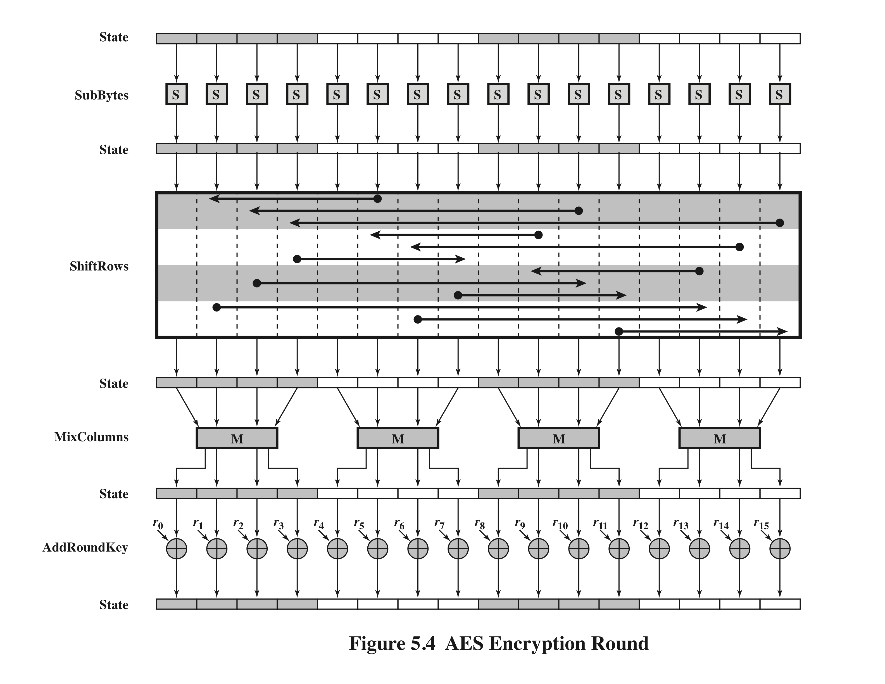

Slide 11
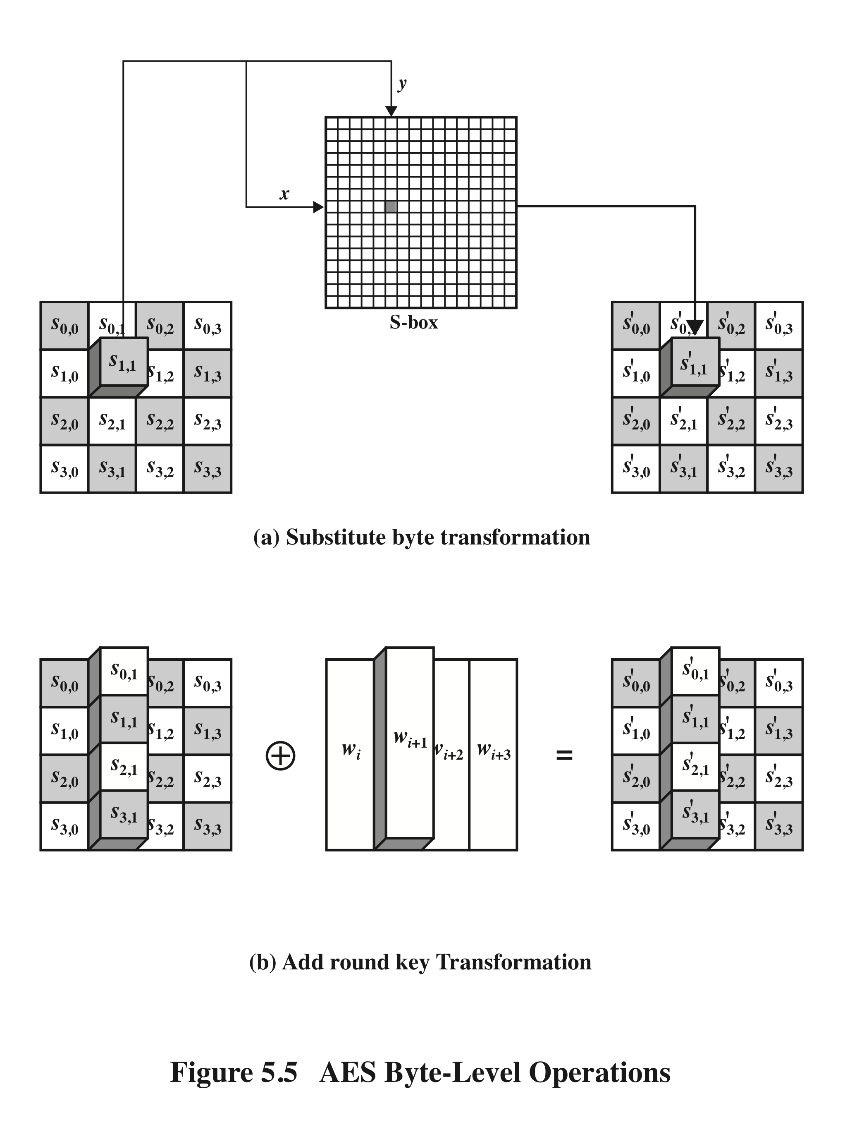
AES Byte Level Operations

Slide 12
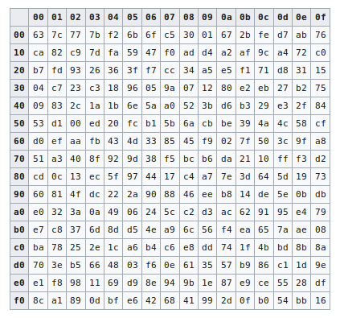
Substitute bytes (S-Box)
The row is determined by the most significant nibble and the column by
the least significant. For example, the value 95₁₆ is converted into 2a₁₆.

Slide 13
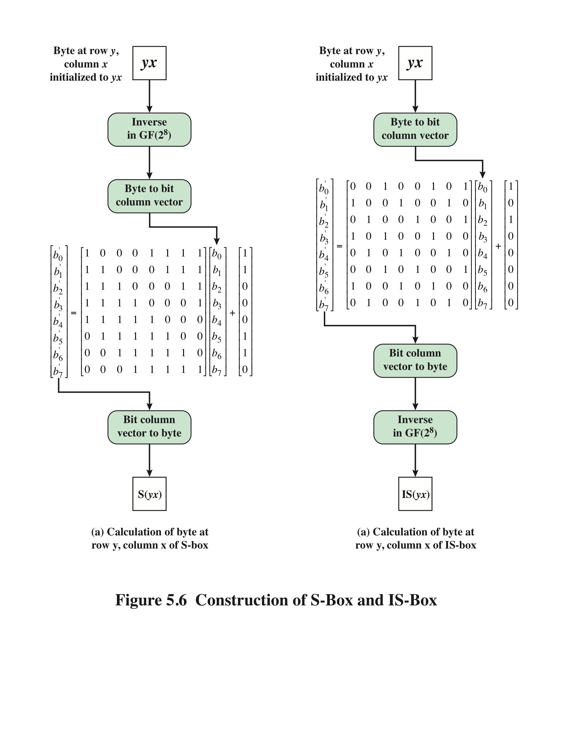
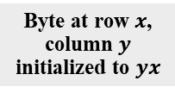
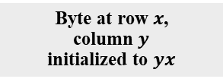
Byte at row $x$,
column $y$
initialized to $yx$
Byte at row $x$,
column $y$
initialized to $yx$
calculation of byte at
row x, column y of S-box
calculation of byte at
row x, column y of IS-box

Slide 14
S-Box Rationale
The S-box is designed to be resistant to known cryptanalytic attacks
The design that has a low correlation between input bits and output bits and the property that the output is not a linear mathematical function of the input
The nonlinearity is due to the use of the multiplicative inverse

Slide 15
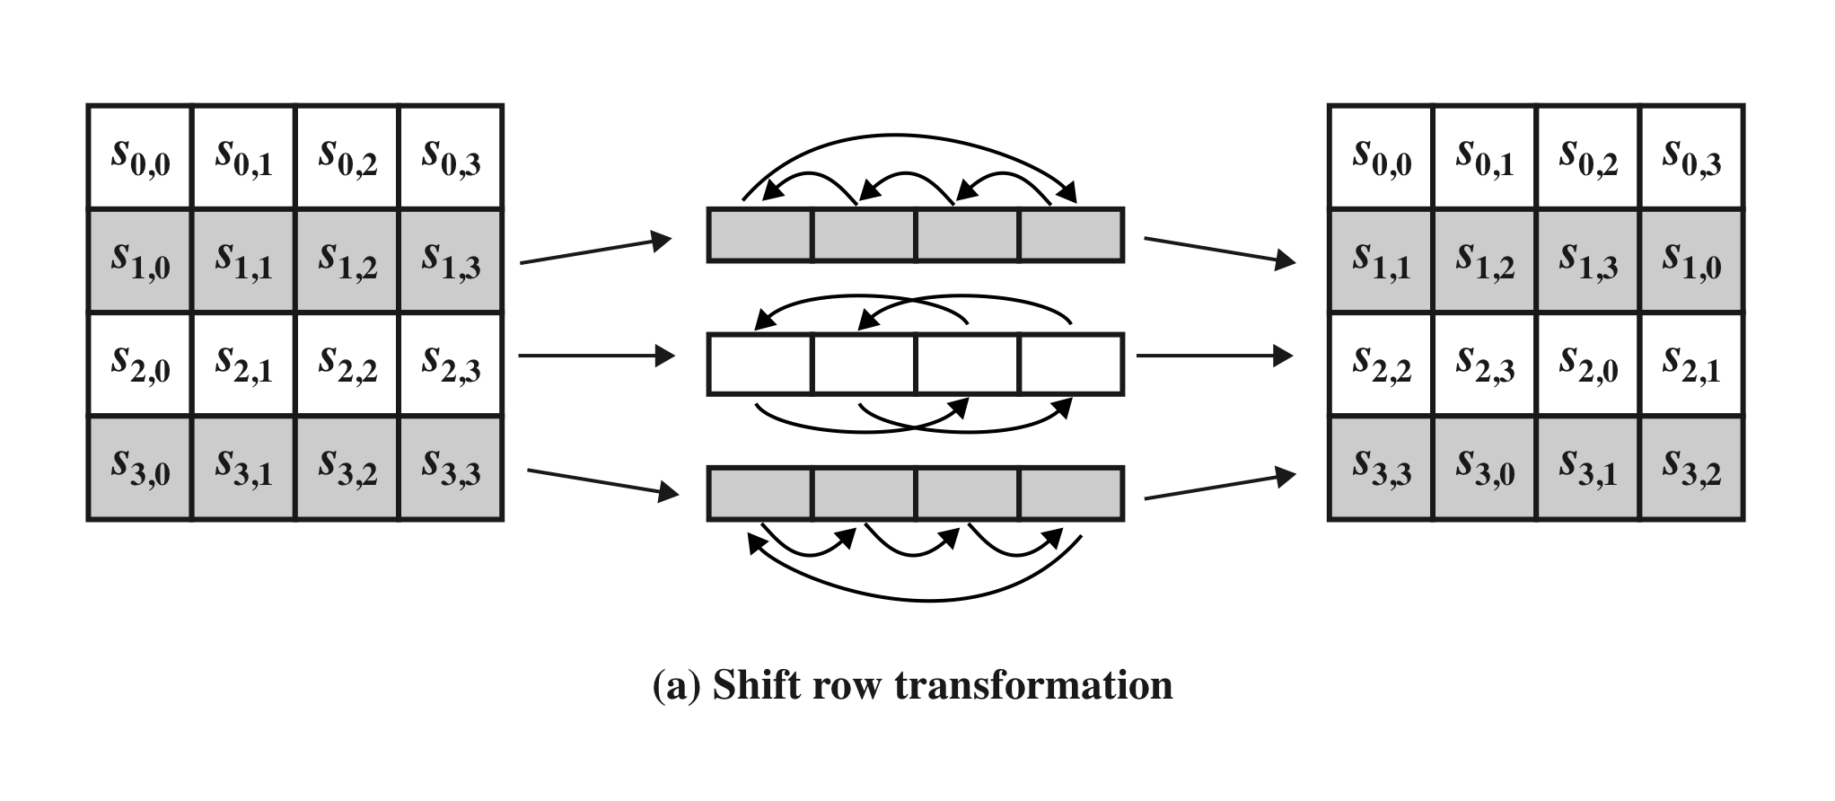
Shift Row Transformation
AES Row and Column Operations

Slide 16
Shift Row Rationale
Transformation ensures that the 4 bytes of one column are spread out to four different columns

Slide 17


MixColumn Transformation
$$s_{0,0}^{′}=2∙s_{0,0}+3∙s_{1,0}+1{∙s}_{2,0}+1∙s_{3,0}$$
AES Row and Column Operations

Slide 18
Mix Columns Rationale
The mix column transformation combined with the shift row transformation ensures that after a few rounds all output bits depend on all input bits

Slide 19
AddRoundKey Transformation
The 128 bits of State are bitwise XORed with the 128 bits of the round key
Operation is viewed as a columnwise operation between the 4 bytes of a State column and one word of the round key
Rationale:
Simple as possible and affecting every bit
The complexity of the round key expansion plus the complexity of the other stages of AES ensure security

Slide 20
AES Key Expansion
Takes as input a 4-word (16 byte) key and produces a linear array of 44 words (176) bytes
Sufficient to provide a 4-word round key for the initial AddRoundKey stage and each of the 10 rounds of the cipher
Key is copied into the first four words of the expanded key
The remainder of the expanded key is filled in four words at a time

Slide 21
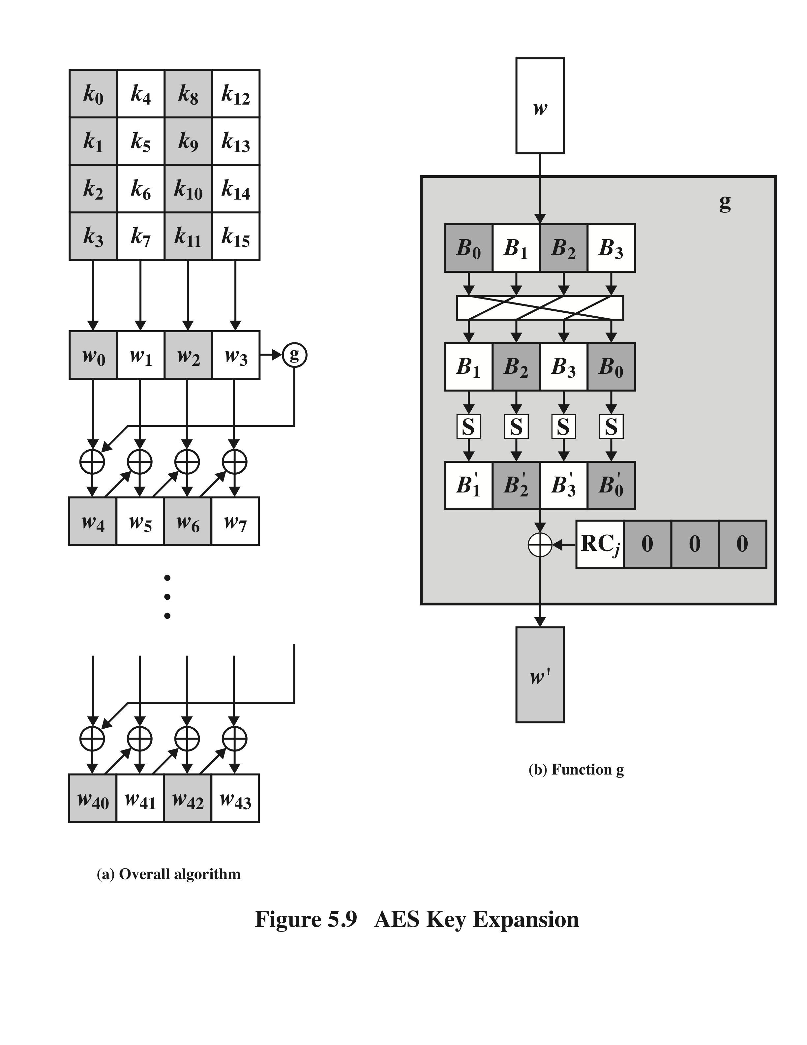
AES Key Expansion

Slide 22
Key Expansion Rationale
The specific criteria that were used are:
Knowledge of a part of the round key does not enable calculation of many other round-key bits
An invertible transformation
Uses round constants to eliminate symmetries
Diffusion of round key differences into the round keys
Simplicity of description
The expansion key algorithm is designed to be resistant to known cryptanalytic attacks

Slide 23
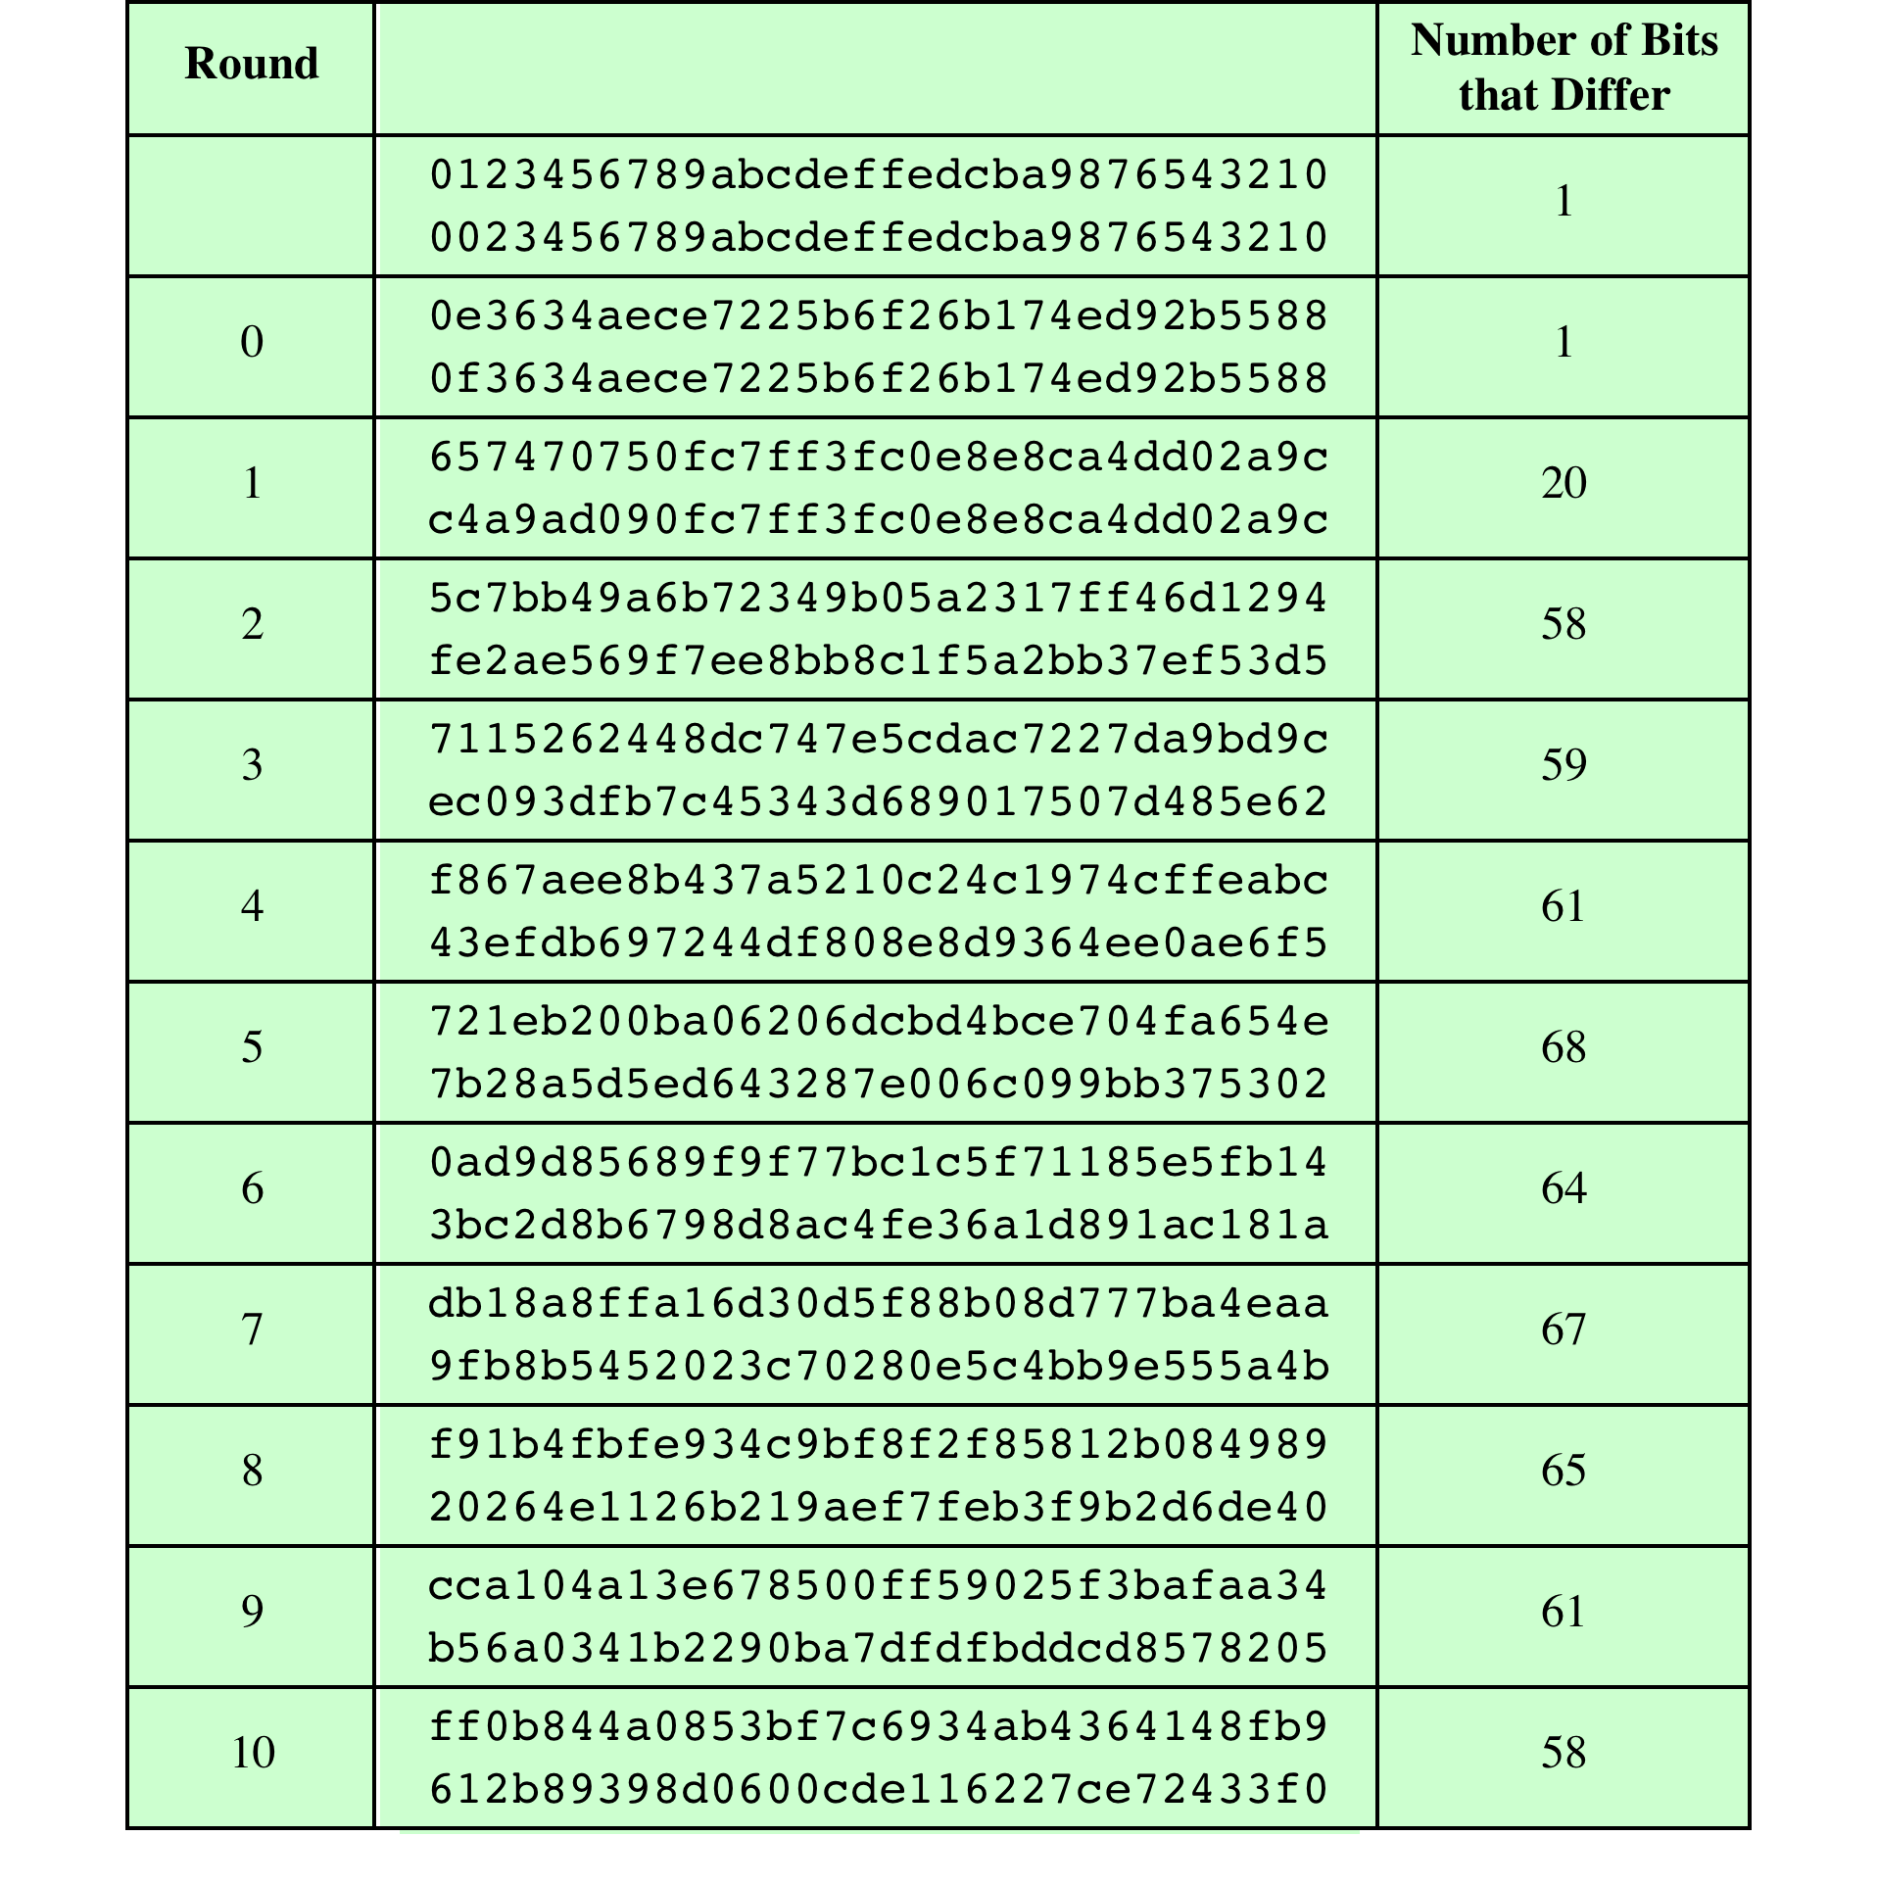
Avalanche Effect
in AES:
Change in plaintext

Slide 24
Equivalent Inverse Cipher
AES decryption cipher is not identical to the encryption cipher
The sequence of transformations differs although the form of the key schedules is the same
Has the disadvantage that two separate software or firmware modules are needed for applications that require both encryption and decryption
Two separate changes are needed to bring the decryption structure in line with the encryption structure
The first two stages of the decryption round need to be interchanged
The second two stages of the decryption round need to be interchanged

Slide 25
Implementation Aspects
AES can be implemented very efficiently on an 8-bit processor
AddRoundKey is a bytewise XOR operation
ShiftRows is a simple byte-shifting operation
SubBytes operates at the byte level and only requires a table of 256 bytes
MixColumns requires matrix multiplication in the field GF(2⁸), which means that all operations are carried out on bytes

Slide 26
Implementation Aspects
Can also be efficiently implement on a 32-bit processor
Redefine steps to use 32-bit words
Can precompute 4 tables of 256-words
Then each column in each round can be computed using 4 table lookups + 4 XORs
At a cost of 4Kb to store tables

Slide 27
Summary
AES transformation functions
Substitute bytes
ShiftRows
MixColumns
AddRoundKey
AES implementation
Equivalent inverse cipher
Implementation aspects
Finite field arithmetic
AES structure
General structure
Detailed structure
AES key expansion
Key expansion algorithm
Rationale

Slide 28
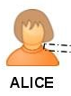

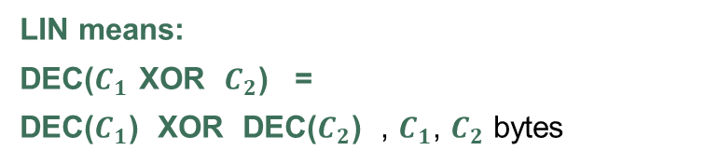
“LIN” -- The hackers card game a chosen ciphertext attack
Dealer
BYTES
ciphertext
10101010
BYTES
plaintext
11001001
BYTES
ciphertext
10101010
LIN means:
DEC($C_{1}$ XOR $C_{2}$) =
DEC($C_{1}$) XOR DEC($C_{2}$) , $C_{1}$, $C_{2}$ bytes
Hacker
BYTES
ciphertext
10000000
BYTES
ciphertext
10000000
BYTES
plaintext
10101010
is allowed 7 more cards

Slide 29
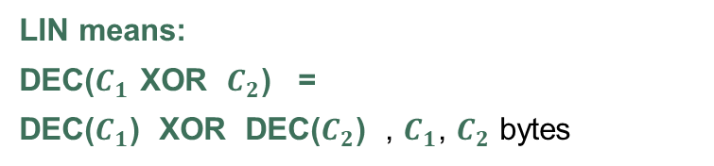
“LIN” -- The hackers card game a chosen ciphertext attack
Dealer
BYTES
ciphertext
10101010
BYTES
plaintext
11001001
BYTES
ciphertext
10101010
LIN means:
DEC($C_{1}$ XOR $C_{2}$) =
DEC($C_{1}$) XOR DEC($C_{2}$) , $C_{1}$, $C_{2}$ bytes
Hacker
BYTES
ciphertext
10000000
BYTES
ciphertext
01000000
BYTES
ciphertext
00001000
BYTES
plaintext
00000011
BYTES
ciphertext
10000000
BYTES
plaintext
10101010
BYTES
ciphertext
00100000
BYTES
ciphertext
0001000
BYTES
ciphertext
00001000
BYTES
ciphertext
00000001
BYTES
plaintext
10100000
BYTES
plaintext
11000000
BYTES
ciphertext
0000010

Slide 30
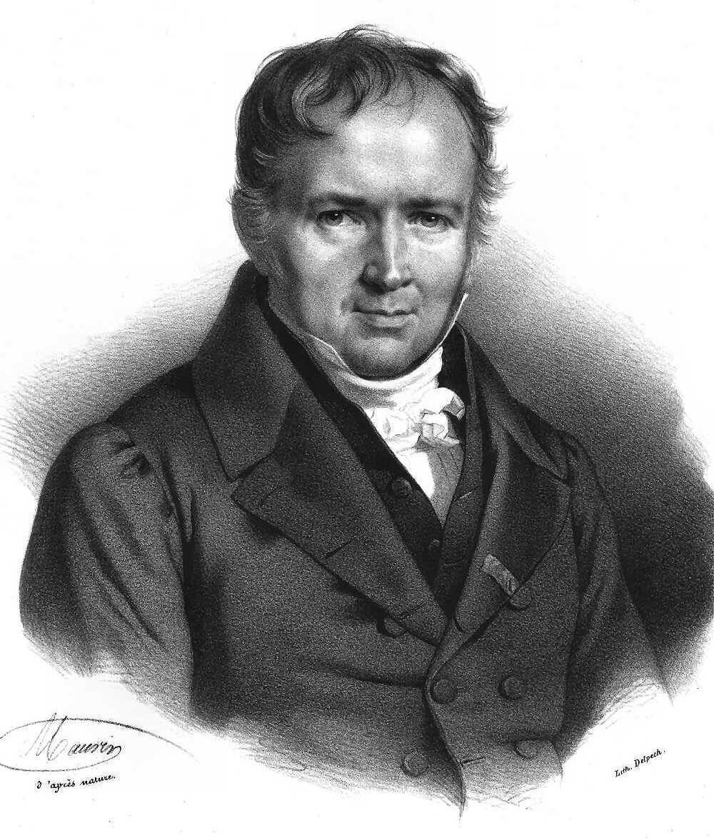
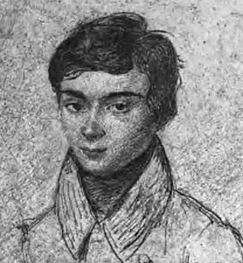
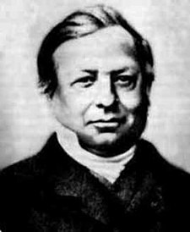
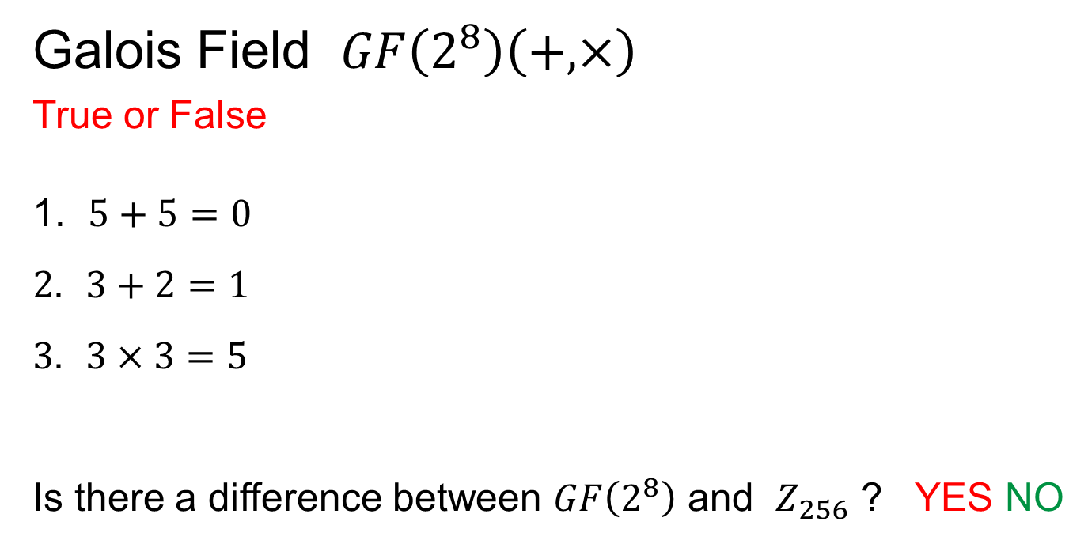
Galois paper is … incomprehensible
Galois Field $GF\left(2^{8}\right)\left(+,×\right)$
True or False
$5+5=0$
$3+2=1$
$3×3=5$
Is there a difference between $GF\left(2^{8}\right)$ and $Z_{256}$ ? YES NO

Slide 31
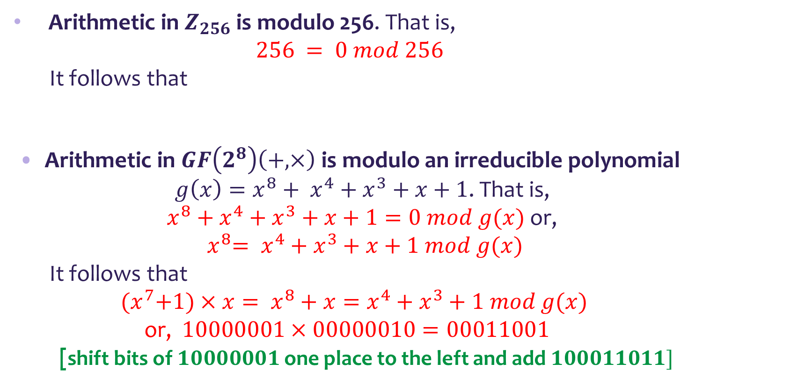
But there are many similarities …
Arithmetic in $Z_{256}$ is modulo 256. That is,
$$256 = 0 mod 256$$
It follows that
Arithmetic in $GF\left(2^{8}\right)\left(+,×\right)$ is modulo an irreducible polynomial ${g\left(x\right)=x}^{8}+ x^{4}+x^{3}+x+1$. That is, $x^{8}+x^{4}+x^{3}+x+1=0 mod g(x)$ or, ${ x}^{8}= x^{4}+x^{3}+x+1 mod g(x)$
It follows that
${ (x}^{7}+1)×x= x^{8}+x=x^{4}+x^{3}+1 mod g(x)$
or, $10000001×00000010=00011001$
[shift bits of $10000001$ one place to the left and add $100011011]$

